Slide 1
Intro to High Performance Computing (HPC)
Jens Mueller, PhD
HPC Services, Miami University

Slide 2
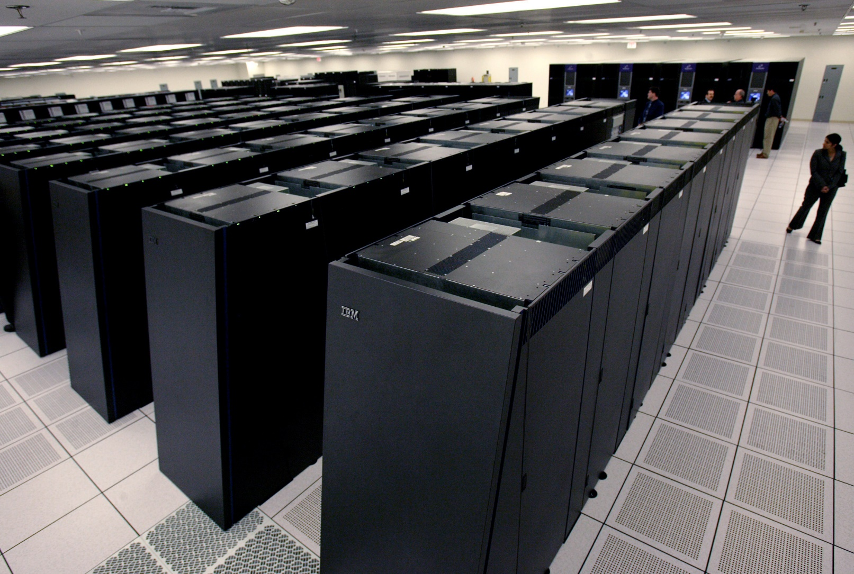
What is a high performance computer/supercomputer ??
http://www.businessinsider.com/r-us-intelligence-agency-aims-to-develop-superconducting-computer-2014-12

Slide 3
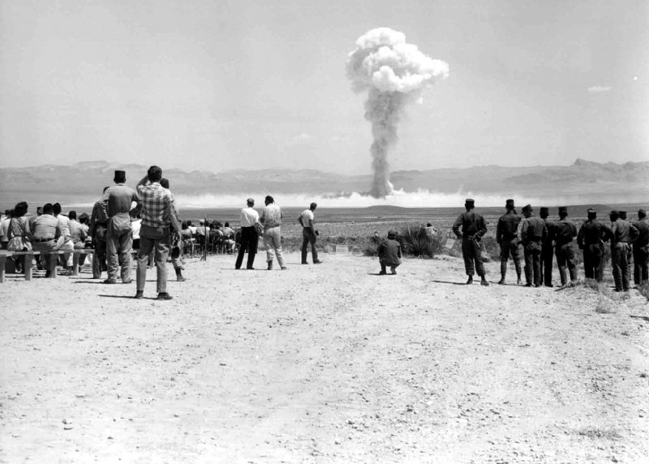
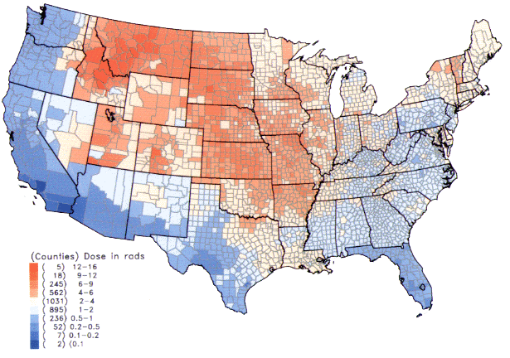
When HPC was not used (yet)

Slide 4
Why “High Performance”
Big number of individual computers/servers make up a cluster
Each computer has powerful processors
Each computer has a lot of memory (RAM)
Each computer has lots of hard drive space
The cluster of computers has a massive amount of storage capacity
and combined compute power

Slide 5
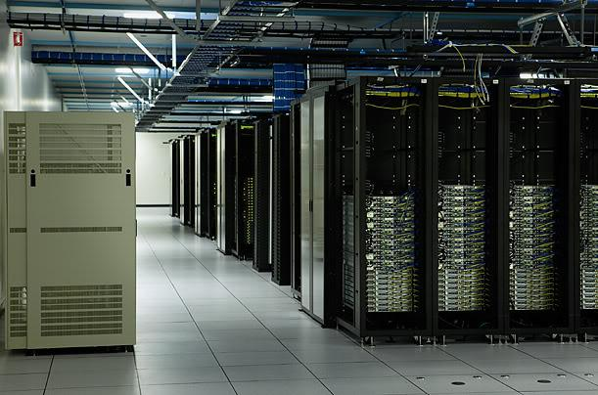
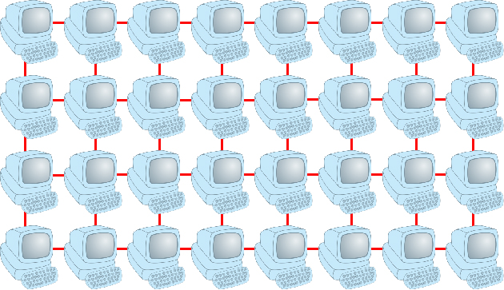
Why “High Performance” II
Cluster Interconnect = Wiring/networking between computers is important !!!
www.time.com

Slide 6
Benefit of “High Performance”
Bigger compute tasks can be tackled
Bigger and more realistic computational models can be created
Bigger data sets can be analyzed
Compute tasks can be completed faster
Number of processors working at the same time
Processors have faster clock speeds (GHz)
Huge data sets can be stored/shared and backed-up

Slide 7
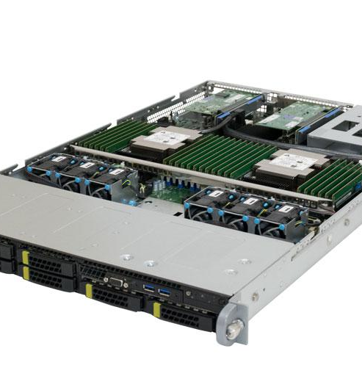
Nodes and cores in an HPC cluster
A “node” is a server or “machine”
Each node has specific number of “compute cores”
Compute cores are part of a processor
There can be several processors in a node
Total core count in a node is just the sum of all cores in the processors
Compute cores can be accessed and reserved individually by a user
https://www.penguincomputing.com/products/servers/relion/relion-xe1112e-server/#composer/1928095279

Slide 8


High end application areas of HPC/supercomputing
SARS Covid 2 Spike protein simulation
1 micro second life of Hepatitis B virus
https://elifesciences.org/articles/32478/figures
https://twitter.com/RommieAmaro/status/1271487699216551941

Slide 9
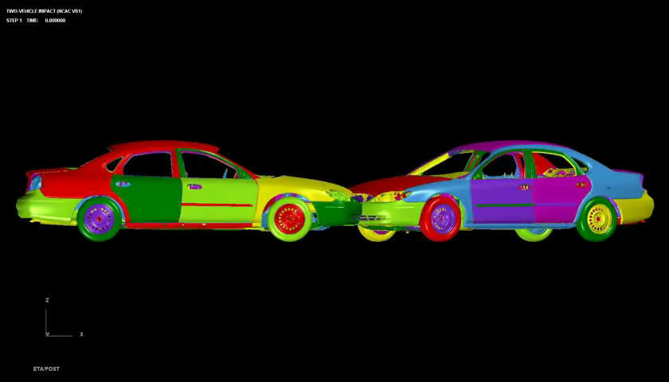
Other areas where HPC is essential
Aerospace engineering: https://www.youtube.com/watch?v=-D5N_OnZ_Tg
Verify operability of (US) nuclear stockpile through simulations: https://www.youtube.com/watch?v=PS_PlorW6pM
Climate and weather:
https://svs.gsfc.nasa.gov/cgi-bin/details.cgi?aid=30017
Automotive
Sports, entertainment, consumer goods industry ….

Slide 10

Weather and climate modeling
http://svs.gsfc.nasa.gov/vis/a030000/a030000/a030017/index.html
The full GEOS‐5 simulation covered 2 years‐‐from May 2005 to May 2007. It ran on 3,750 processors of the Discover supercomputer at the NASA Center for Climate Simulation, consuming 3 million processor hours
and producing over 400 terabytes of data.

Slide 11
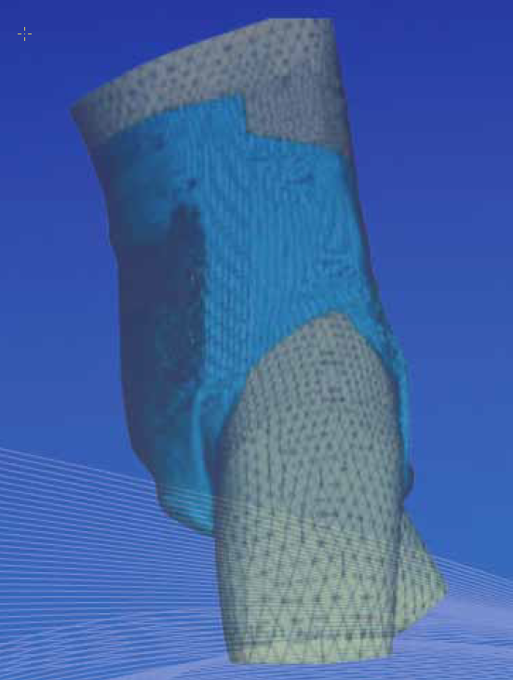

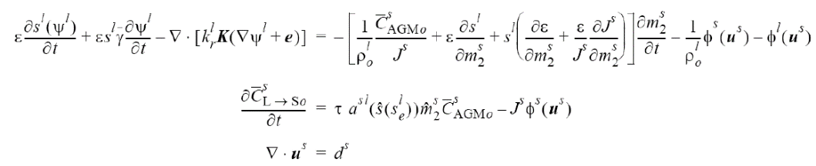

Where HPC is used: Consumer Goods
http://whispersandshouts.typepad.com/pgs-digital-revolution.pdf
http://www.feflow.info/uploads/media/Rosati.pdf

Slide 12
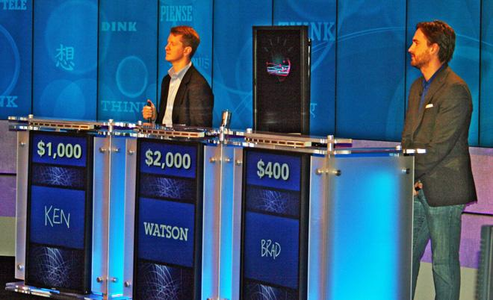
Where HPC is used: Entertainment

Slide 13

Where HPC is used: Movie Industry
Disney’s Big Hero 6 rendered on 55,000 core supercomputer
5 Petabytes of storage
https://www.engadget.com/2014-10-18-disney-big-hero-6.html

Slide 14

Where HPC is used: Sports
Undisclosed Team has acquired Cray supercomputer
“Urika” (~$ 1 Mio)
• Analyze data based on over 140 years of detailed
information on individual players, teams, and
winning trends
• Supposed to help team owners make better future
decisions based on past data
• Urika is “Hypothesis machine”: What happens if you
replace average player with another player
From HPC Wire, April 3, 2014

Slide 15

Facebook, et. al.
No immediate need for ultra fast interconnect switches but many other aspects of supercomputers apply:
• Huge storage space
• Data Routers
• Backup systems
• Power supplies
• OS: Linux
• Cooling
abcnews.com

Slide 16
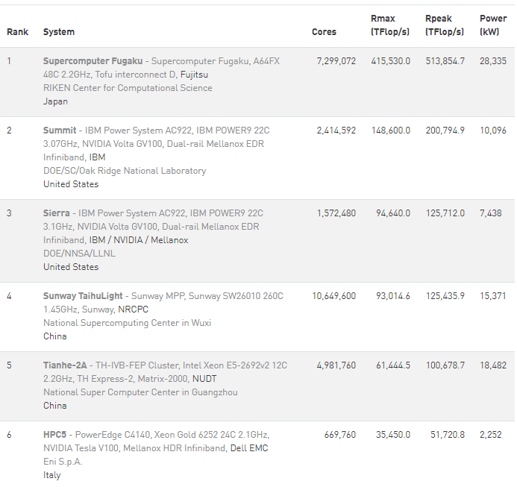
Top 500 Supercomputers from top500.org

Slide 17

Supercomputers in the US

Slide 18
Supercomputers in the US
Oakridge National Lab (TN)
Lawrence Livermore National Lab (CA)
Lawrence Berkeley National Lab (CA)
Los Alamos National Lab (NM)
NASA Ames Research Center (CA)
National Center for Supercomputing Applications Urbana (IL)
TACC at utexas in Austin (TS)

Slide 19
Redhawk cluster
39 servers (nodes) total
2 log-in nodes, 32 “compute” nodes
26 regular compute nodes
4 GPGPU nodes
2 big memory nodes
Servers built by Penguin Computing
Purchase date: summer 2018
Total cost: ~ $ 400,000
(Biggest supercomputer in the world: 4,608 nodes, > $200 Mio cost)

Slide 20
Redhawk cluster, server details
All nodes have 2 Intel Xeon Gold Processors 6126, 2.6 GHz, 24 cores total,
Regular compute nodes have 96GB of RAM
2 Big Memory nodes have 1.5TB of memory
4 GPU nodes have 2 Nvidia Tesla V100-PCIE-16GB GPUs each

Slide 21

Parallelism
Embarrassingly parallel (“Embarrassingly” is a technical term)
Each core in the cluster runs the same code
independently from each of the other processors
Input a1,b1
c1= a1+b1
Output c1
Input a2,b2
c2=a2+b2
Output c2
Input a3,b3
c3=a3+b3
Output c3

Slide 22
Parallelism II
Open MP (Multi Processing) parallelism:
Takes advantage of multi core architecture, only a single program is run
Only works within a compute node
Can significantly speed up the code
Performance is subject to scaling constraints
Often used in for-loops:
In case there are 8 cores each core can work
on a subset of the iteration indices 1-8, 9-16 etc.
Iterations need to be independent:
b(i) = doSomething( b(i-1) ) WON’T work in general!
for i=1:64
b(i) = doSomething(i)

Slide 23
Parallelism III
MPI (Message Passing Interface) parallelism:
Uses communication in-between compute cores and nodes
Takes advantage of both multi-core architecture of individual node as well as multi-node architecture of the cluster
Adds significant complexity to program code
Performance is subject to scaling constraints
Each instance of the program is executed on a compute core and is associated with an MPI “rank” (0,1,2…,MPI_size)
a1+b1=c1
c=c1+c2+c3
a2+b2=c2
c=c1+c2+c3
a3+b3=c3
c=c1+c2+c3

Slide 24
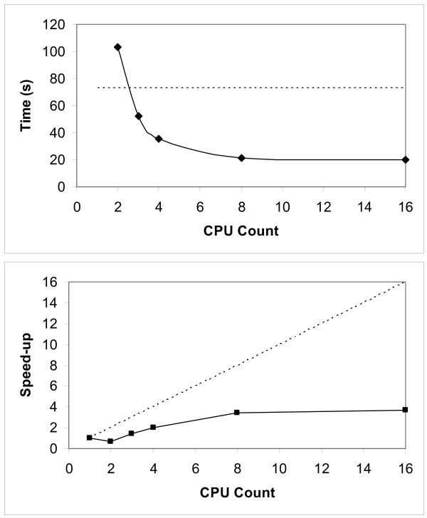
Factoring in scaling behavior
Every program scales differently
Programs scale differently for specific “input” cases
When over-allocating then resources get wasted (particularly bad in a pay-per-cycle environment)
Always need to think about how much overall run time is acceptable versus the gains by using parallel resources
“Embarrassingly” parallel execution always gives ideal scaling
https://www.researchgate.net/figure/Performance-and-strong-scaling-of-the-parallel-correlation-function-Top-graph-shows-the_fig4_23711211

Slide 25
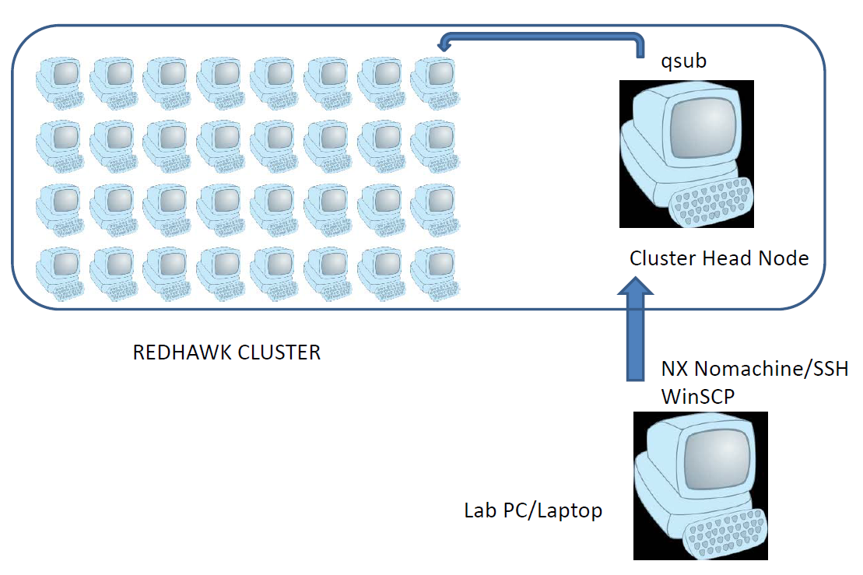
Cluster Architecture

Slide 26
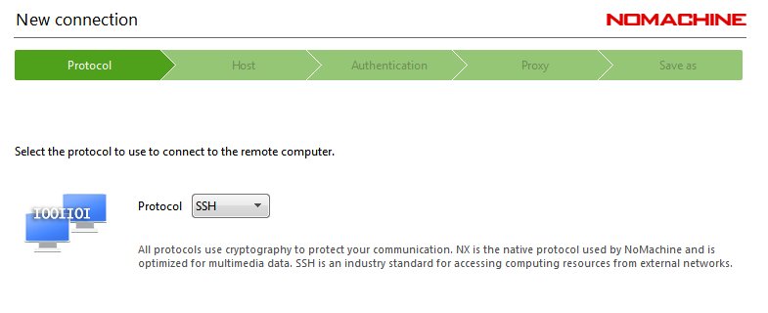
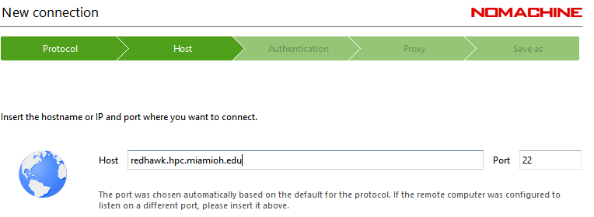
Accessing the Redhawk cluster
Get client at nomachine.com
Choose ssh protocol
Specify hostname:
Enter UniqueID when prompted for username, enter MU password
Accept defaults on all following screens and hit OK

Slide 27
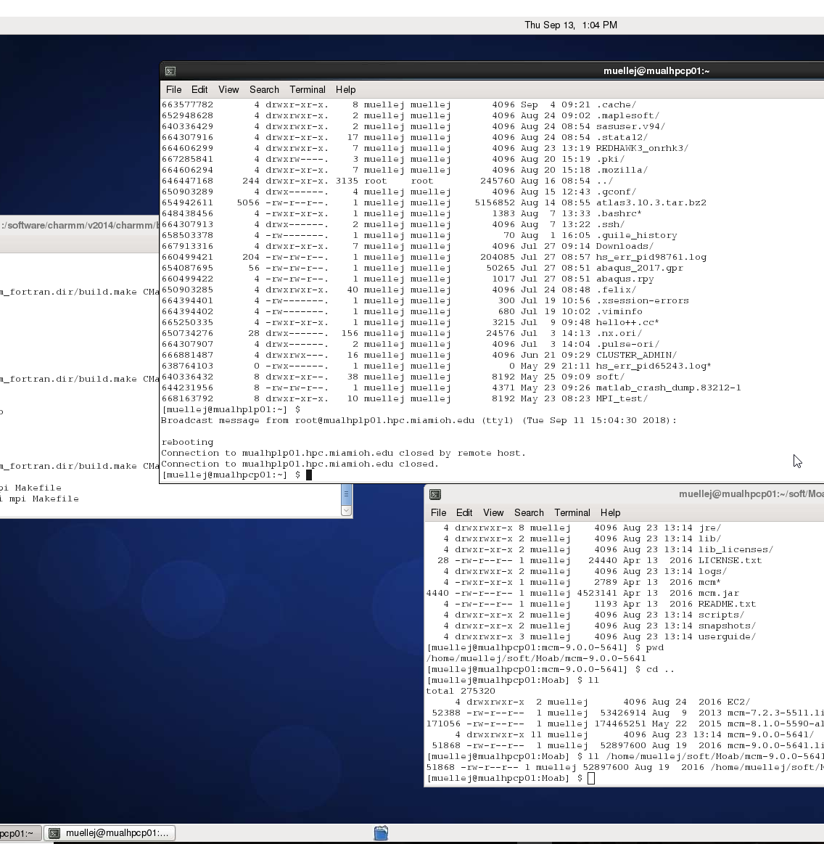
Using Nomachine to access the cluster

Slide 28
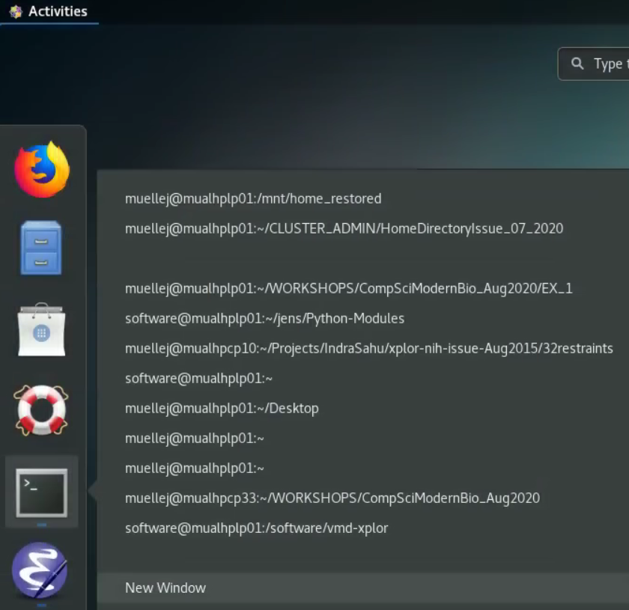
Linux Terminal
In Activities, right-click terminal symbol: New Window

Slide 29
Cluster resource management
Scheduler and resource manager:
Compute jobs need to be sent to a wait queue so proper resources can be allocated
Allocation requests include number of nodes, cores and time, among others
An automatic fair share policy is in effect if demand exceeds availability
Both “interactive” and “batch” jobs are possible
All resource requests are made via the “qsub” command:
Requesting 1 node and 1 core on it for a duration of 80 hours (interactive):
qsub -IV -l nodes=1:ppn=1 -l walltime=80:00:00
Note the command prompt change.

Slide 30
Resource management and prioritization
“showq” provides current resource usage
Helps to make decisions about own planned resource requests
Resource requests need to strike a balance between available resources and required/desired resources.
Smaller wall time request increases chances to get job from wait (Q) into running (R) status
Same holds for smaller number of nodes/cores in the request

Slide 31
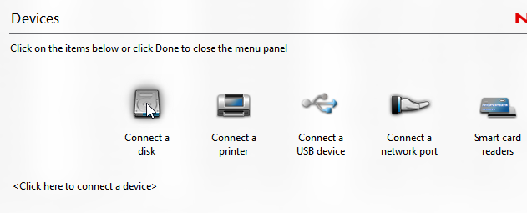

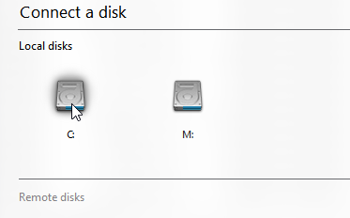
Moving data to/from cluster

Slide 32
Commands in Linux shell I
ls –la: directory listing
gedit file.txt: edit a file
module load matlab: load the vmd environment variables into your environment setting
matlab&: launch Matlab GUI
<command>&: ‘&’ Puts execution of command in “background”
Can continue editing in same shell, or launch ‘top –u <username>’

Slide 33
Commands in Linux shell II
cd /path/to/directory : Change into specified directory
pwd : shows you present working directory
more file.txt : prompts the content of the file file.txt to the screen (file listing)
history : displays history of all previously issued commands
<arrow key up/down>: previous/next command

